Slide 1
Coach Notes
Today’s project is fun but if students have difficulty building the circuit it will hamper the progress of the lesson.
Recommend joining the zoom early and walking students through the wiring step by step.

Slide 2
Machine Learning With Raspberry Pi LED Matrix
AI Code Academy

Slide 3
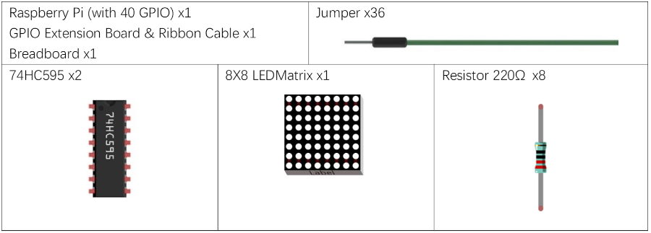
Materials Needed
For this lesson, we’ll need the following materials:
Raspberry Pi with SSH and VNC connection
Breadboard
GPIO extension board and wire
8 x 220 Ohm resistor
LED Matrix
74HC595

Slide 4
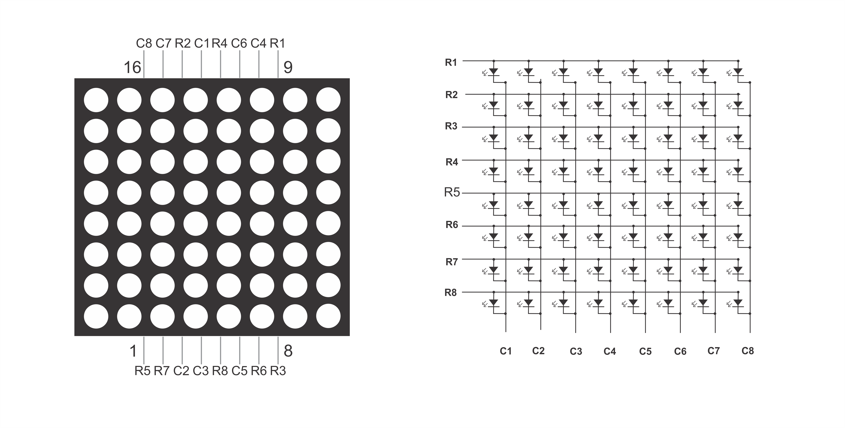
LED Matrix
The LED matrix is comprised of 8 rows and 8 columns of LEDs where many LEDs share cathodes and andoes.
The LED matrix and other LED displays operate simialrly to the 4-Digit 7-Segment display where we will turn on LEDs for a breif moment and then turn off, creating the illusion that all are on.
The wiring of the matrix will determine if the LEDs will be common anode or cathode.

Slide 5
LED Matrix
For this project, we will wire the matrix so that it will be common anode and we will apply power to the row and bring the columns to GND if we want to turn them on.
To use the display as common cathode, we would illumnate each column one at a time.
We will use two shift registers for this lesson.
One will output the data sent to the columns and one will be turn on one row at a time.

Slide 6
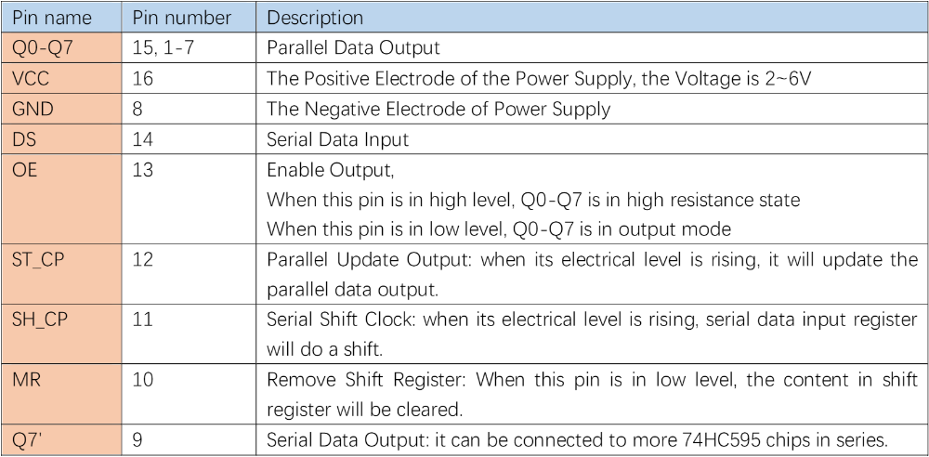
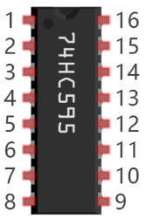
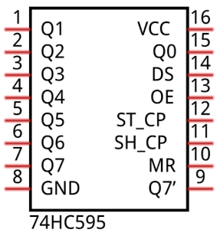
Integrated Circuit (IC) Review
The 74HC595 is an integrated circuit used to store data sent from a serial input and output it as parallel data. The register can perform shift operations and store 1 byte of data. Using this chip, we can output data from the Pi and only need to use 3 pins rather than 8.

Slide 7
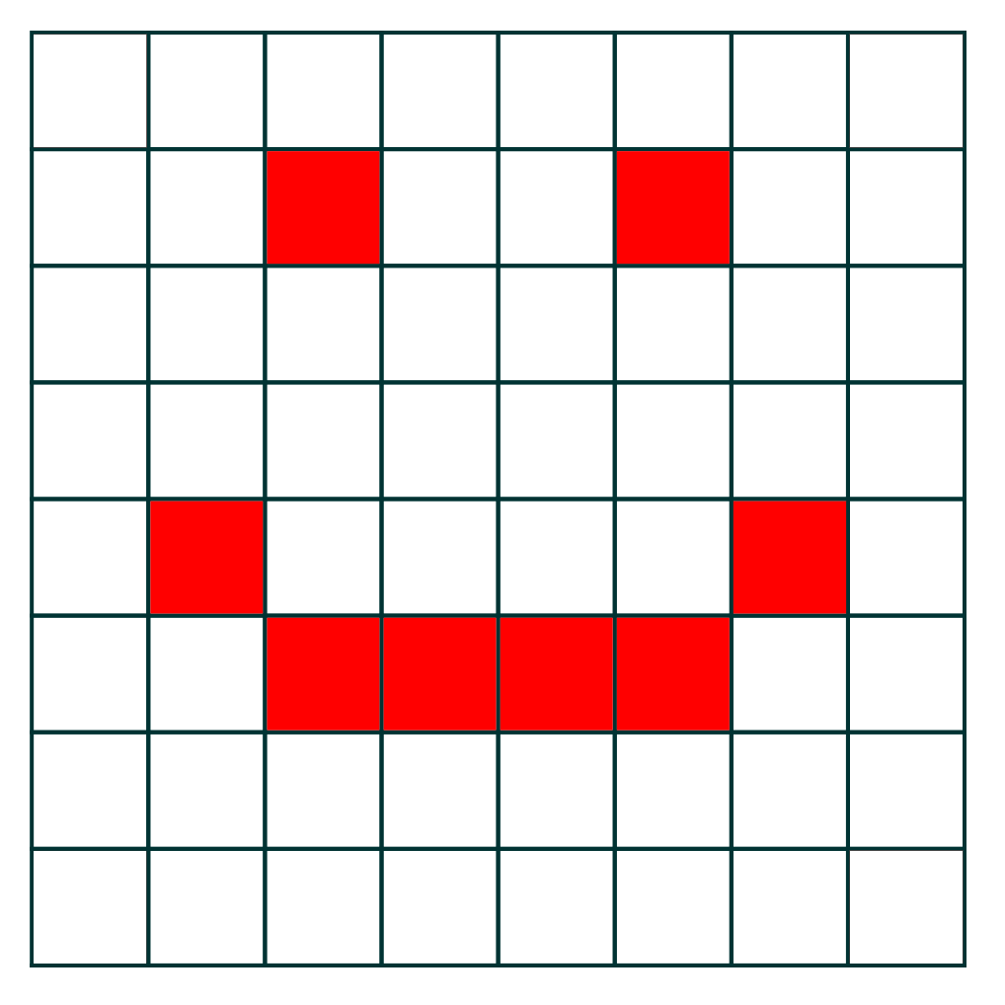
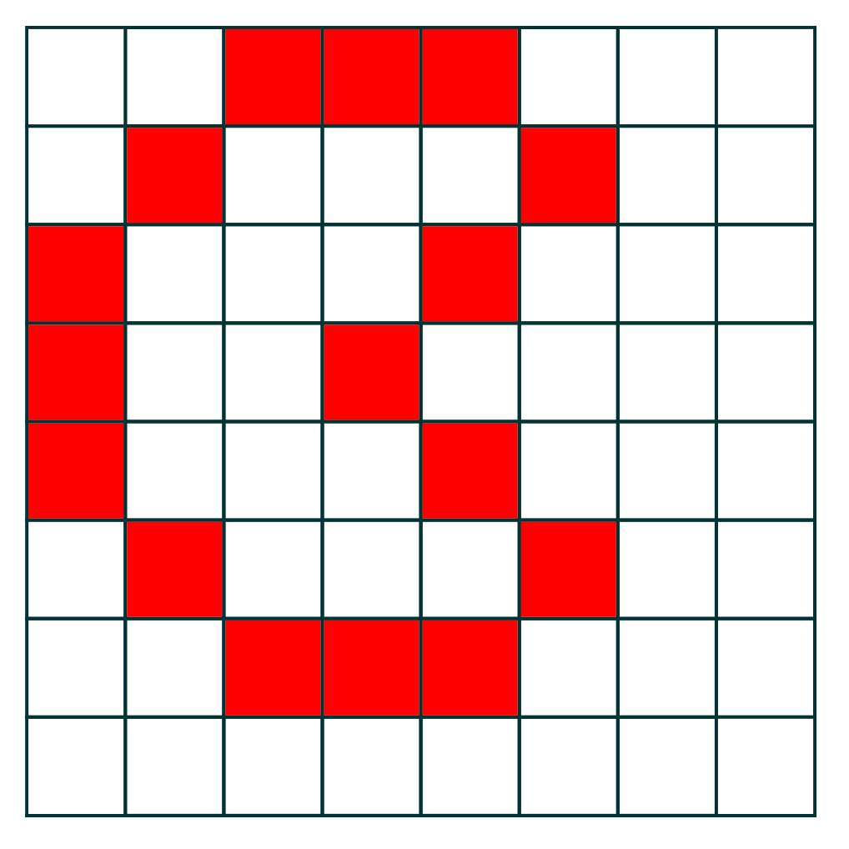
Picture Data
Here are a couple examples of pictures you can create on the display.
The data is saved in hexadecimal or binary in lists and to turn on an LED, we must output a 0.
What is the binary data for the smile?
Row 1: | 0b1111_1111 | Row 5: | 0b1011_1101
Row 2: | 0b1101_1011 | Row 6: | 0b1100_0011
Row 3: | 0b1111_1111 | Row 7: | 0b1111_1111
Row 4: | 0b1111_1111 | Row 8: | 0b1111_1111

Slide 8
Project
For our project, we will display different pictures on the display, and you will get the chance to design your own.
We will first create the smile and then spend time to create our own image and have the image switch after some time.
You can create an animation and have each individual frame be displayed on the screen.

Slide 9
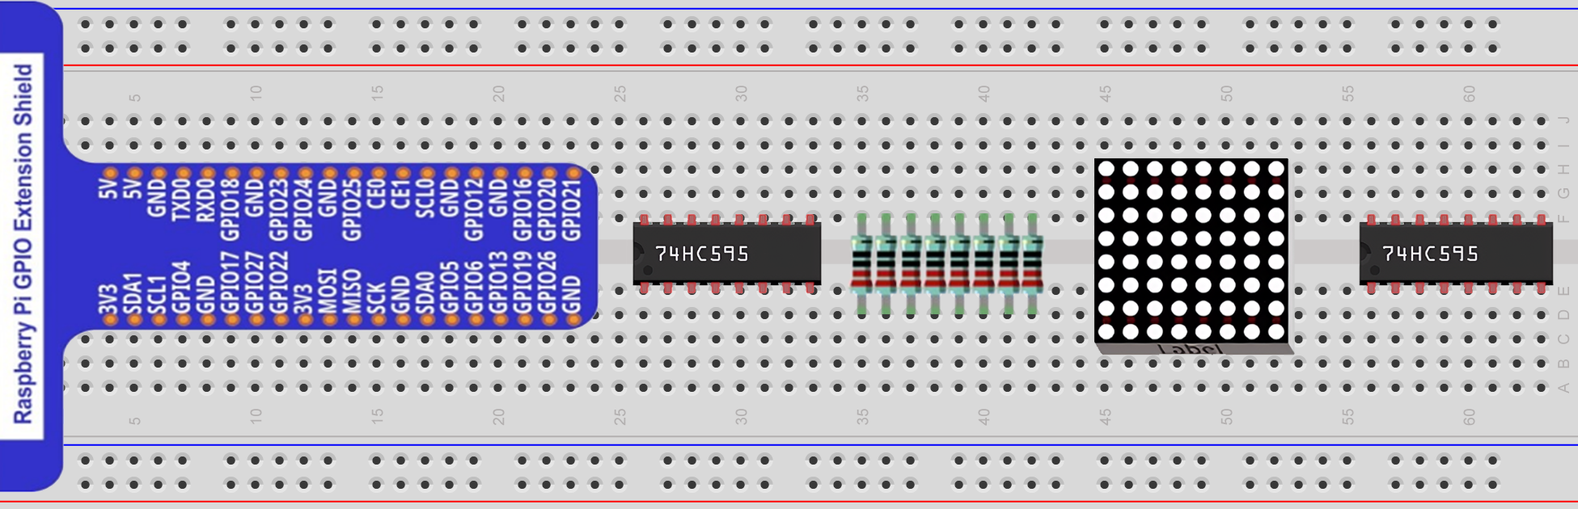
Circuit for this Project
This project’s wiring is very difficult so we will first look at the circuit without the connection wires.

Slide 10
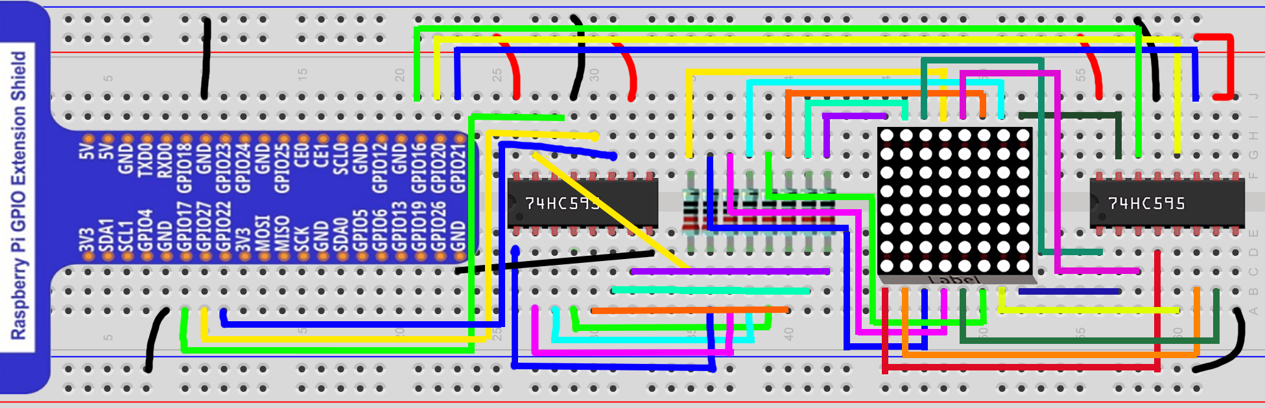
Circuit for this Project

Slide 11
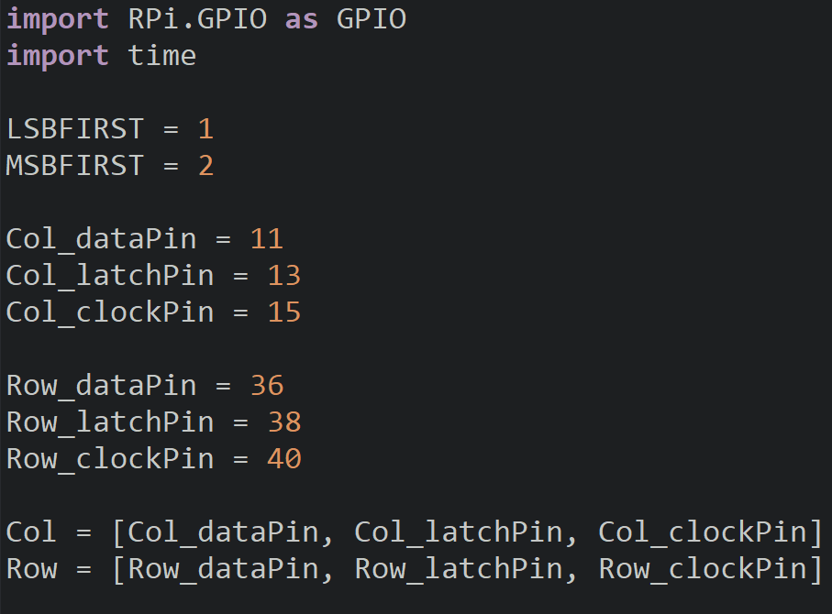
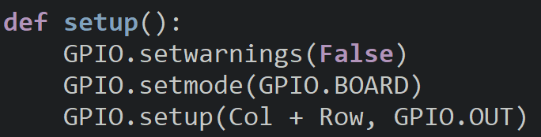
Setup
Create variables for the data, latch, and clock pins for the two shift registers.
We will store the column and the row pins in seperate lists for easy access.
Setup the pins as outputs.

Slide 12
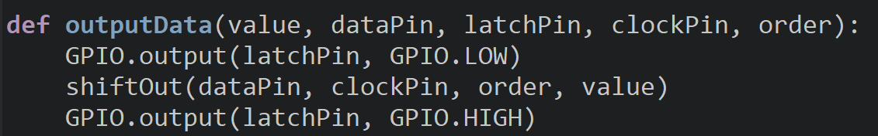
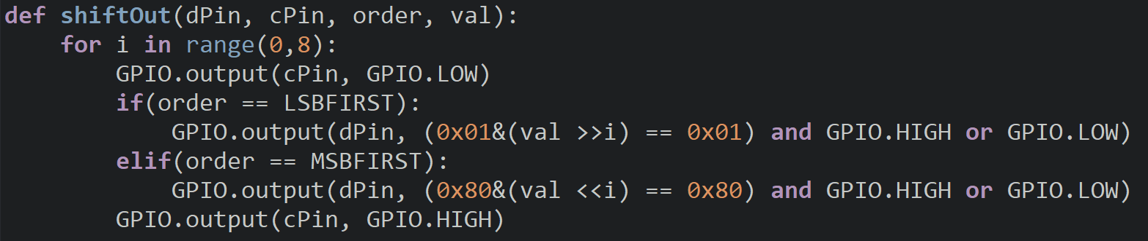
Display Functions
We will create the outputData function to generalize the process of sending data to a shift register since we have two in this project.

Slide 13
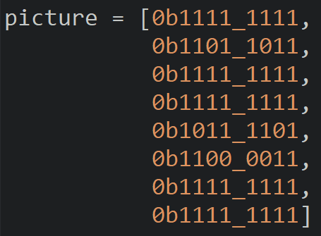
Image Data
Create a variable called picture to store a list containing each row of the picture.
This image data will create a smiley face.

Slide 14
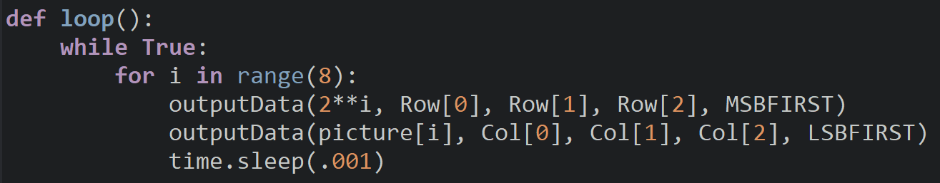
Loop
One way we can output data to the rows to turn each one on is to use powers of two.
This will produce 0x01 for the first row, so when we output this to the register it will assigned 1 to the bit controlling the last row which will draw the picture upside down. To fix this, we will output our data using MSBFIRST.
Output each row of our picture to the column register using LSBFIRST and add a delay.

Slide 15
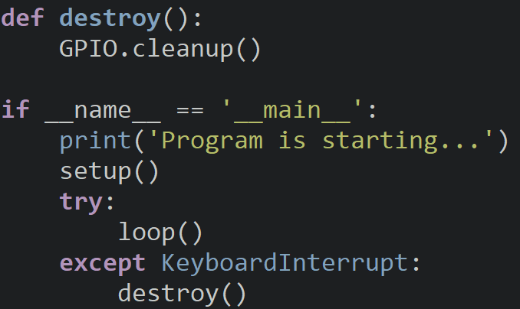
LED Matrix.py
The destroy and program entrance.

Slide 16
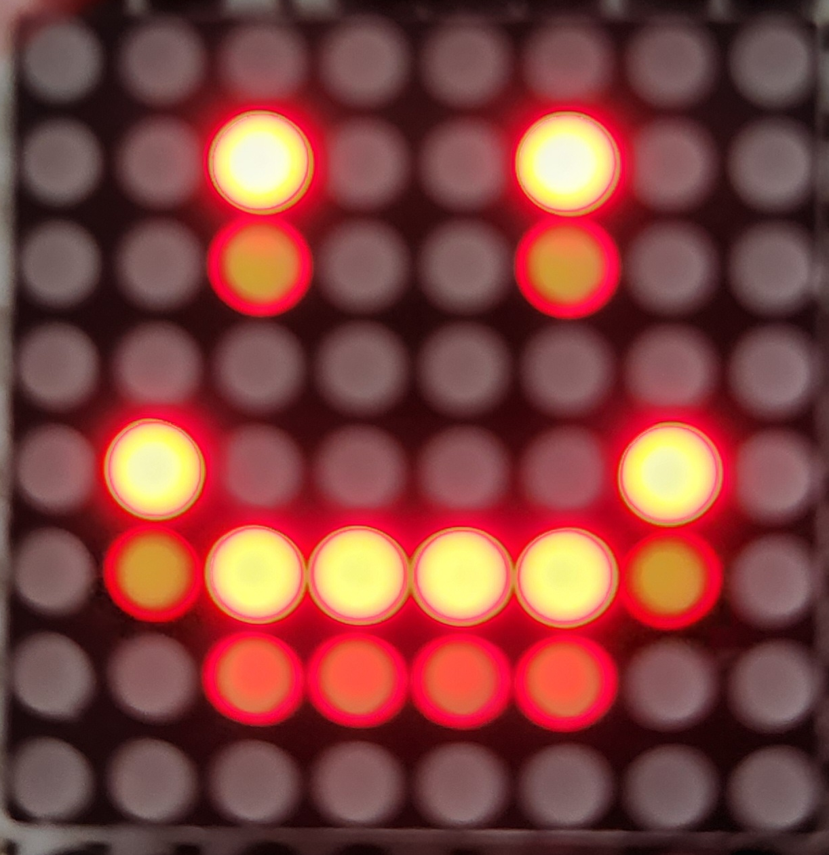
Try It Out
Are you able to see your image?
Do you see other LEDs turned on?
We will address the second copy of our image next since it will ruin our pictures.

Slide 17
LED Ghosting
In our previous lesson we mentioned that we wanted to avoid ghosting.
Ghosting is when LEDs that are supposed to be off are one with a faint glow.
The problem is that the shift register takes time to change the values inside of it and the LEDs need time to get rid of the energy inside.
If we change this too quickly, the energy will not exit in time, and we can output the previous data to the display for a short time creating the faint image.
We can remove ghosting by turning the LEDs off for a short moment before sending in the new column data.

Slide 18
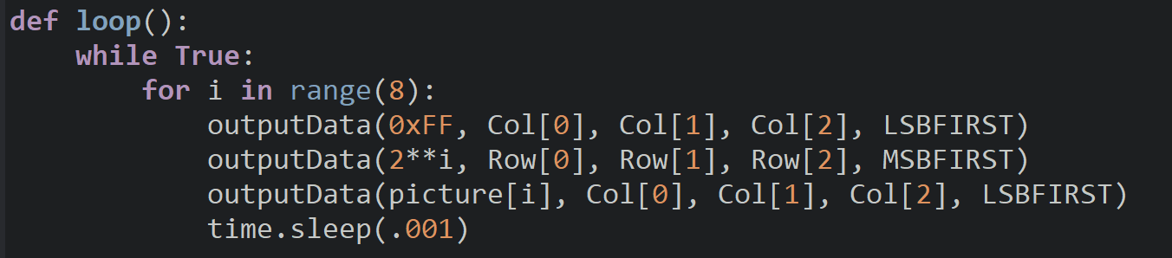
Removing Ghosting
To prevent ghosting, we will output 0xFF (all 1’s) to the shift register which will turn all the LEDs off.
Add this to the beginning of the loop so that there is a longer delay before the new data is sent. If ghosting persists, add a delay after we turn the LEDs off.

Slide 19
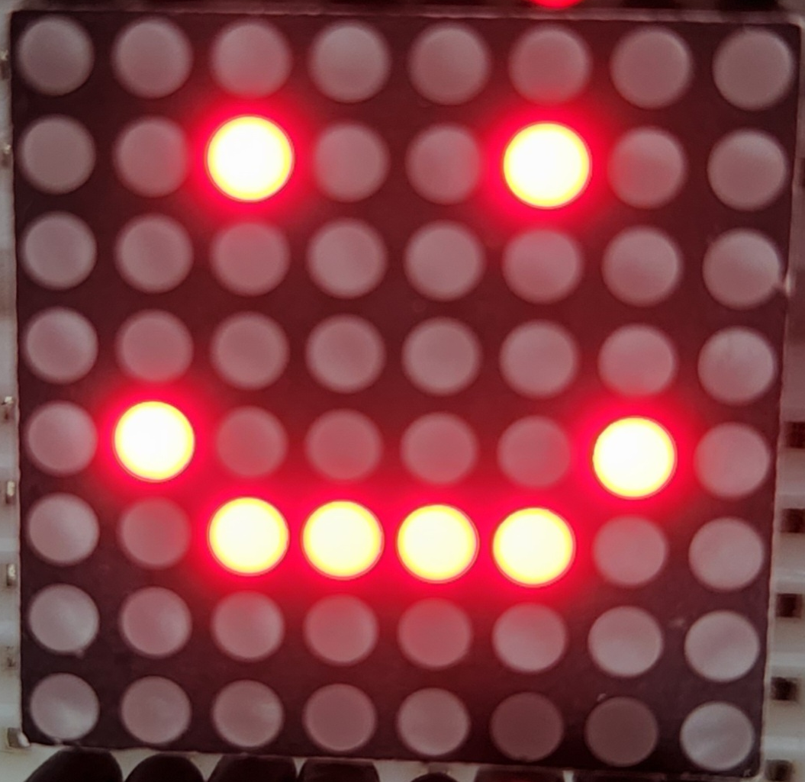
Try It Out
Are there any more ghost pixels in our image?
How could we display more images?

Slide 20
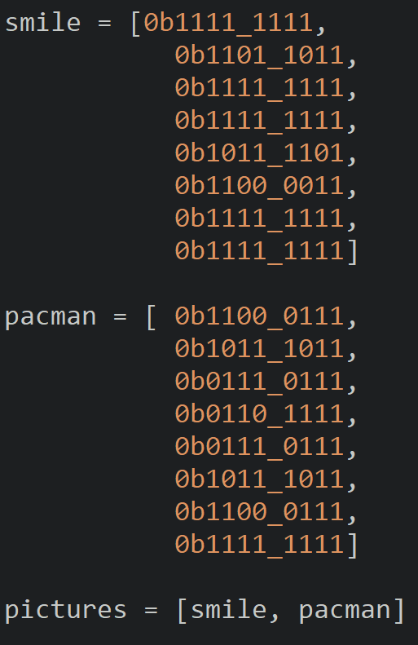
Adding More Pictures
Create another variable for a new picture and add the data for it.
Take some time to find a picture online or draw your own and find the color data for it.
Try searching for 8x8 pixel art online or open a painting program to draw an image.
Create a list to store the images we want to display.
Notes:
They can lookup 8x8 pixel art

Slide 21
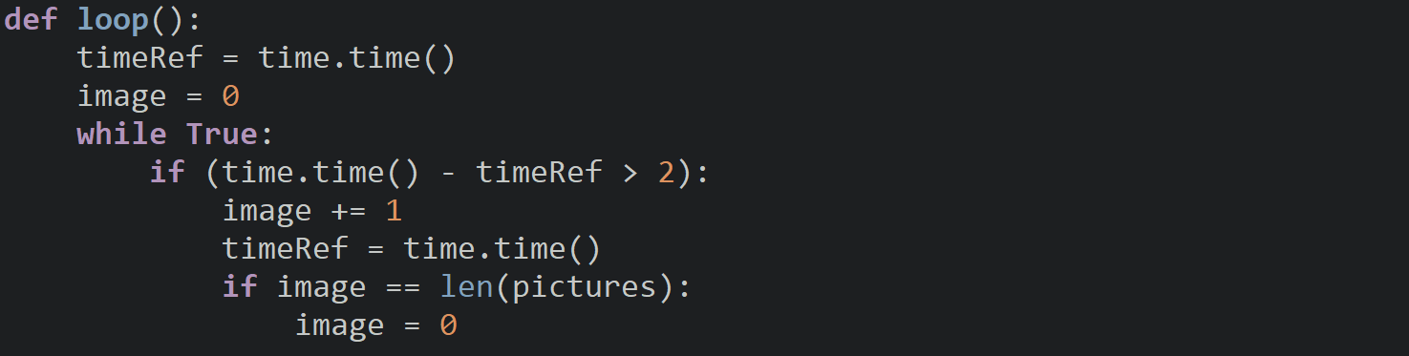
Adding More Pictures
Create variables to keep track of which image to display and one for the time.
Every two seconds we will change the image displayed and allow the loop to return to the first image.
Notes:
They can lookup 8x8 pixel art

Slide 22
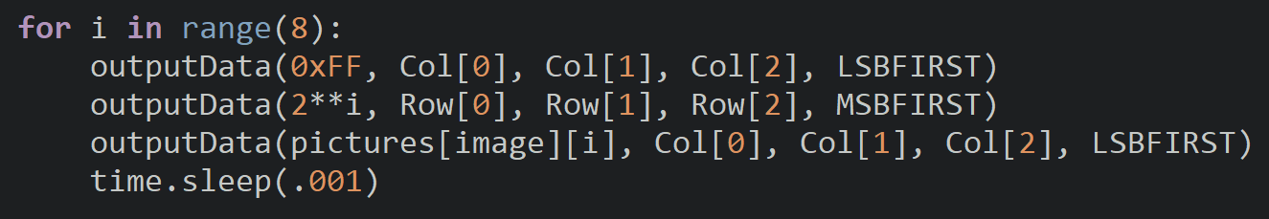
Adding More Pictures
The last change we will make is indexing the pictures list to get the image we want and then getting the row.
Notes:
They can lookup 8x8 pixel art

Slide 23
Discussion
Where you able to see the images your created?
What are the limitations of the LED Matrix?
What projects could we use the LED Matrix in?

Slide 24
Power off
As usual, shut down your pi properly before disconnecting power.

